Slide 1

Movie Score data analysis
-Nitin Gowda

Slide 2
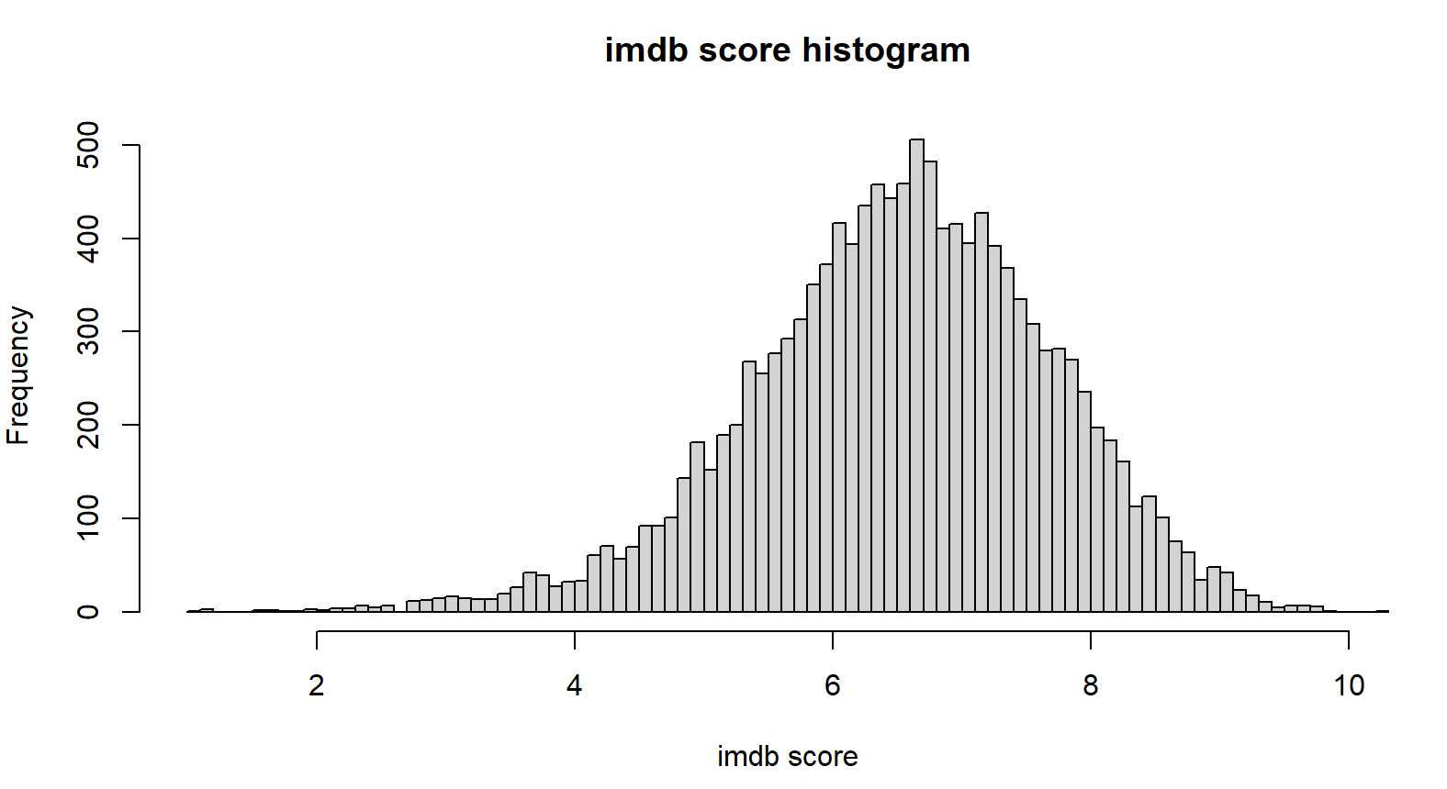
IMDB score frequency
Graph shows the frequency distribution of imdb scores
From the graph, most imdb scores are between 6 and 8
Least imdb scores are from 0 to 4 and from 8 to 10.

Slide 3
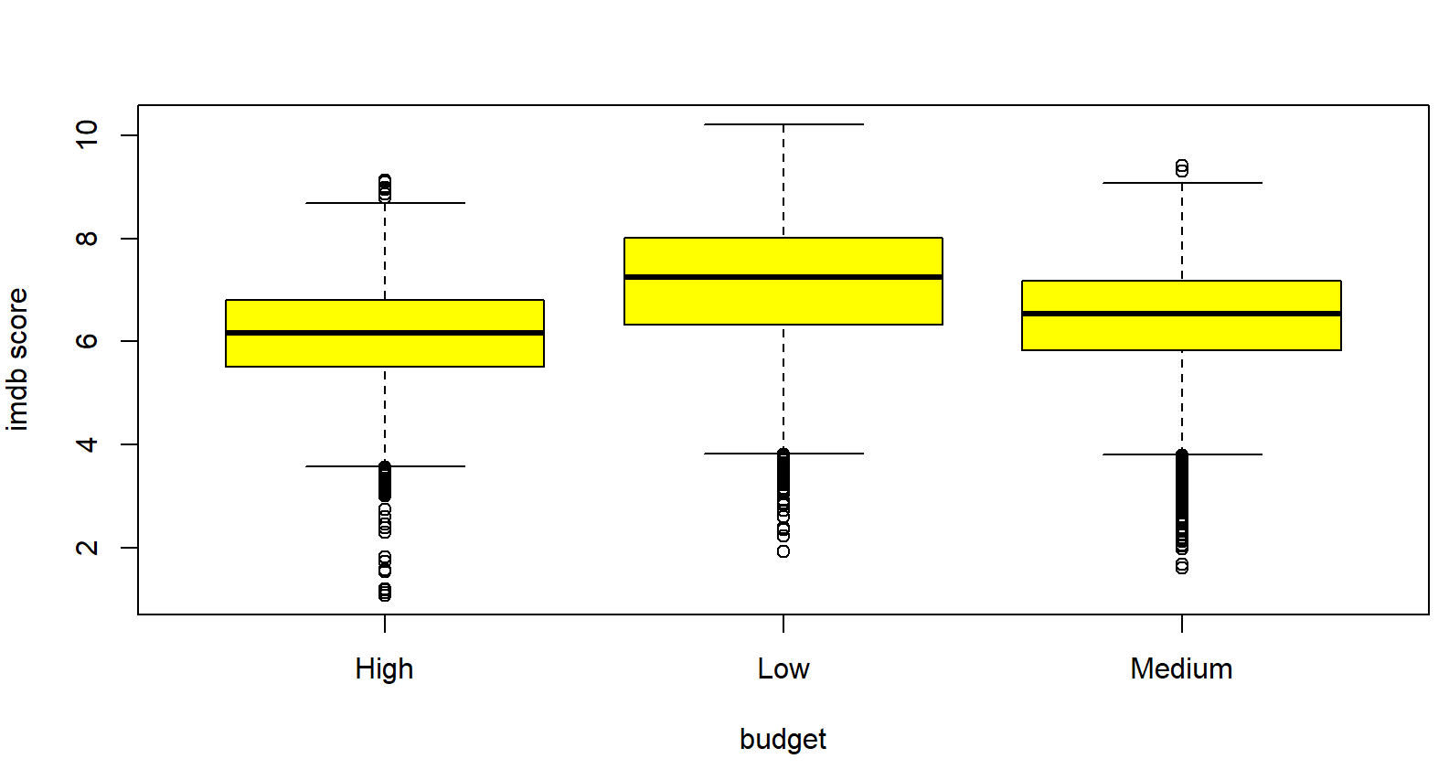
Budget vs Score
On plotting budget vs score, we observe that low budget films tend to receive higher imdb scores than high and medium budget films
This is surprising as most would expect higher budget films to be ‘better’ than lower budget films

Slide 4
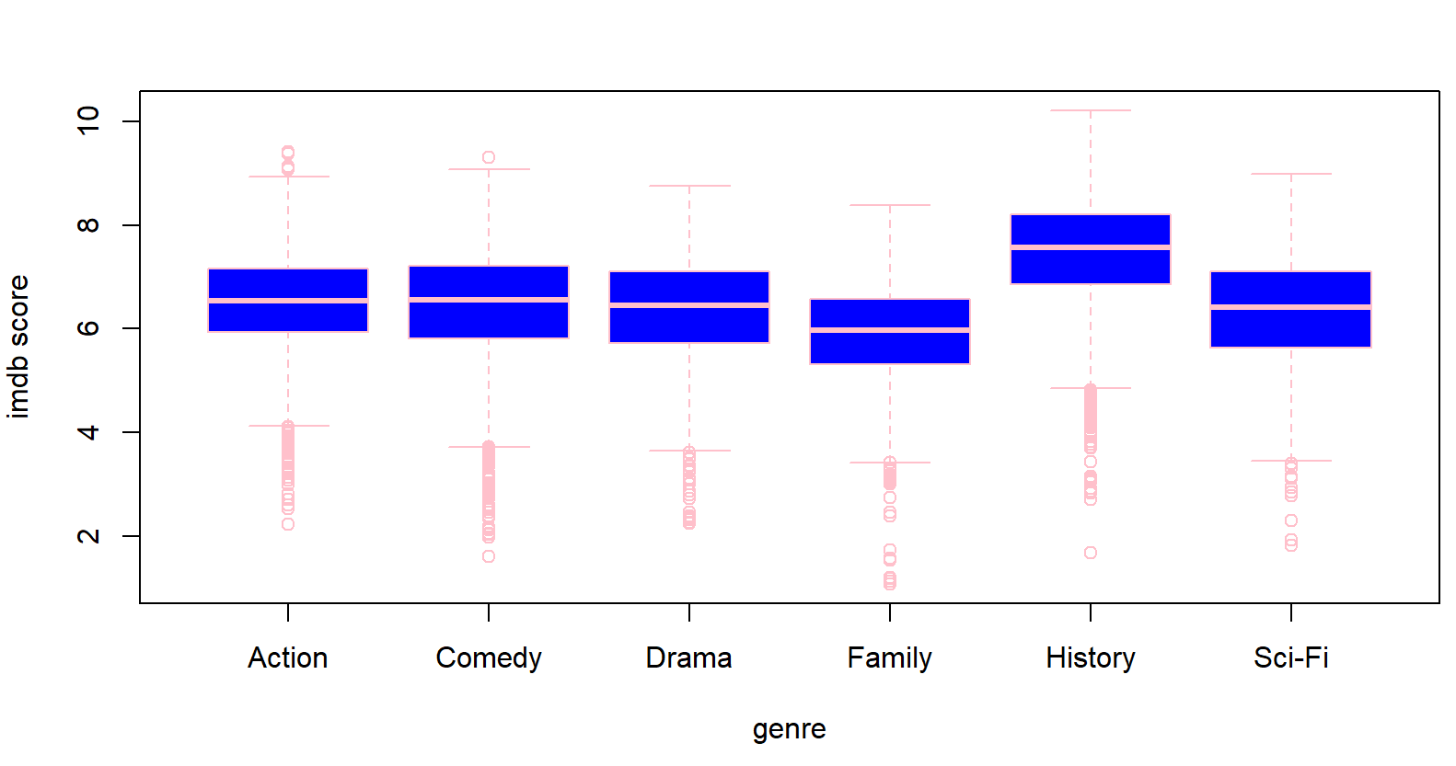
Genre vs imdb scores
We observe that history movies tend to receive higher imdb scores than other genres. This may be due to the lower abundance of history movies in theatres, therefore leading to more effort put into making these films.
We can also infer that family movies tend to score less, which may be due to the abundance of family movies in theatres, leading to lesser effort put into making these movies due to a bigger market.

Slide 5
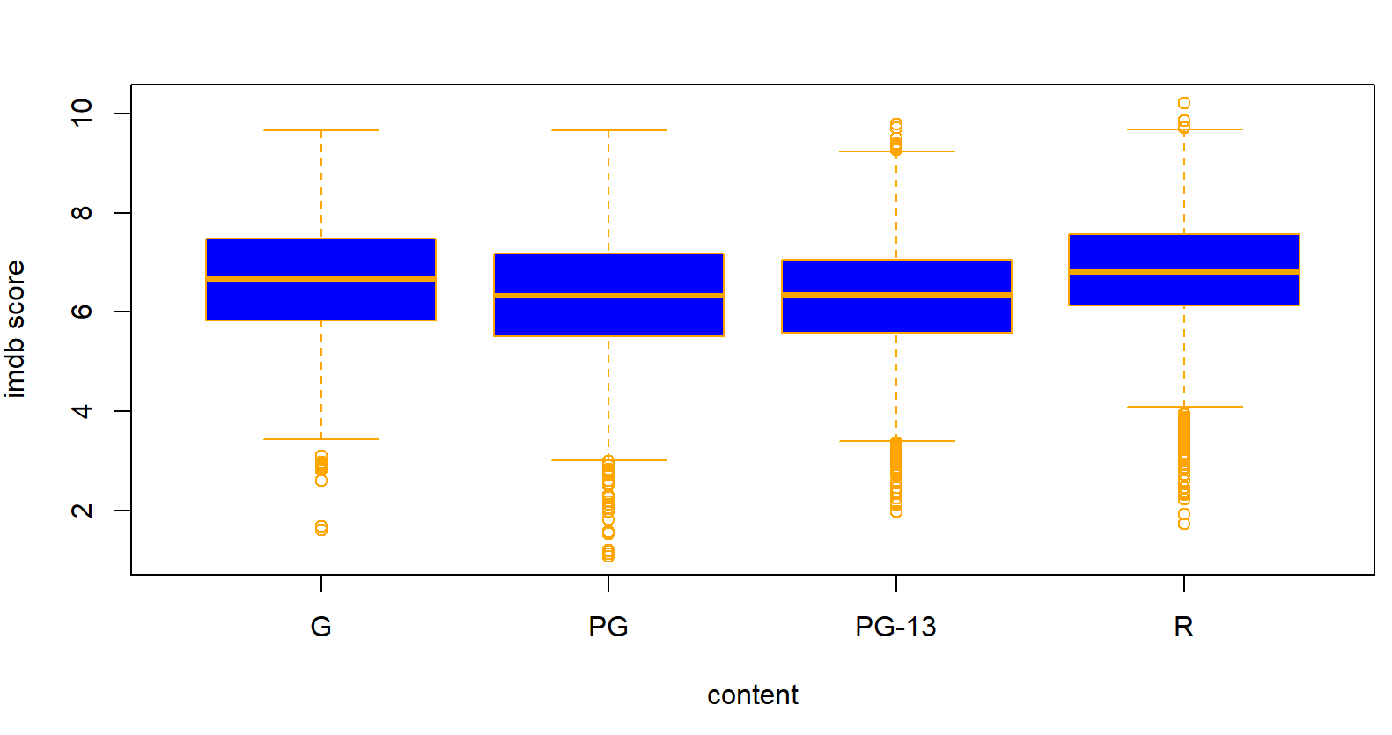
Score vs imdb score
On observing this graph, R rated movies and G rated movies tend to score higher than PG and PG-13 movies score
There may not be a direct reason for this, and this is probably just a coincidence.

Slide 6
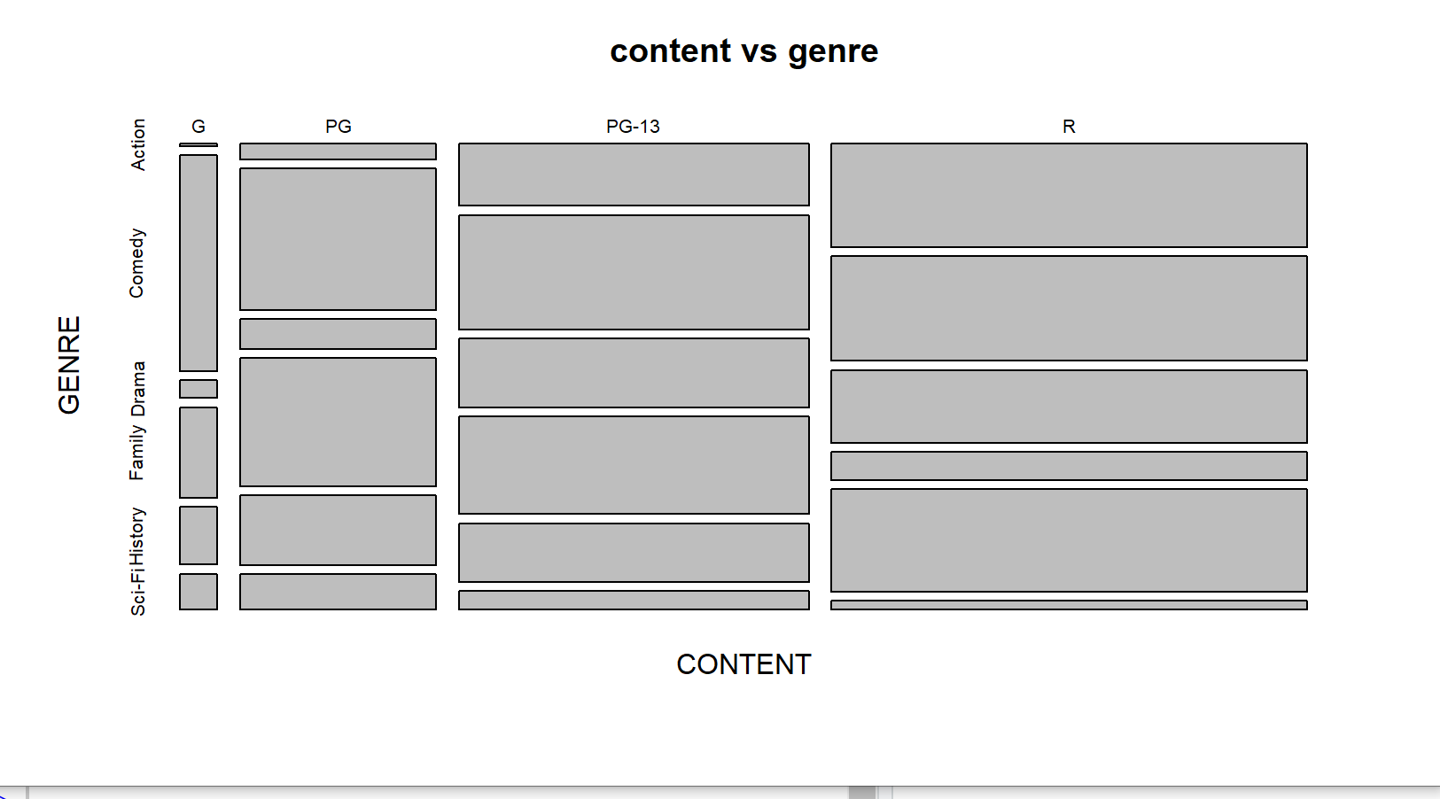
Content vs genre
From the graph, most action movies are R rated, most comedy movies are G rated, drama movies are mostly split, most family movies are PG, most history movies are R rated, and most sci-fi movies are G or PG.

Slide 7
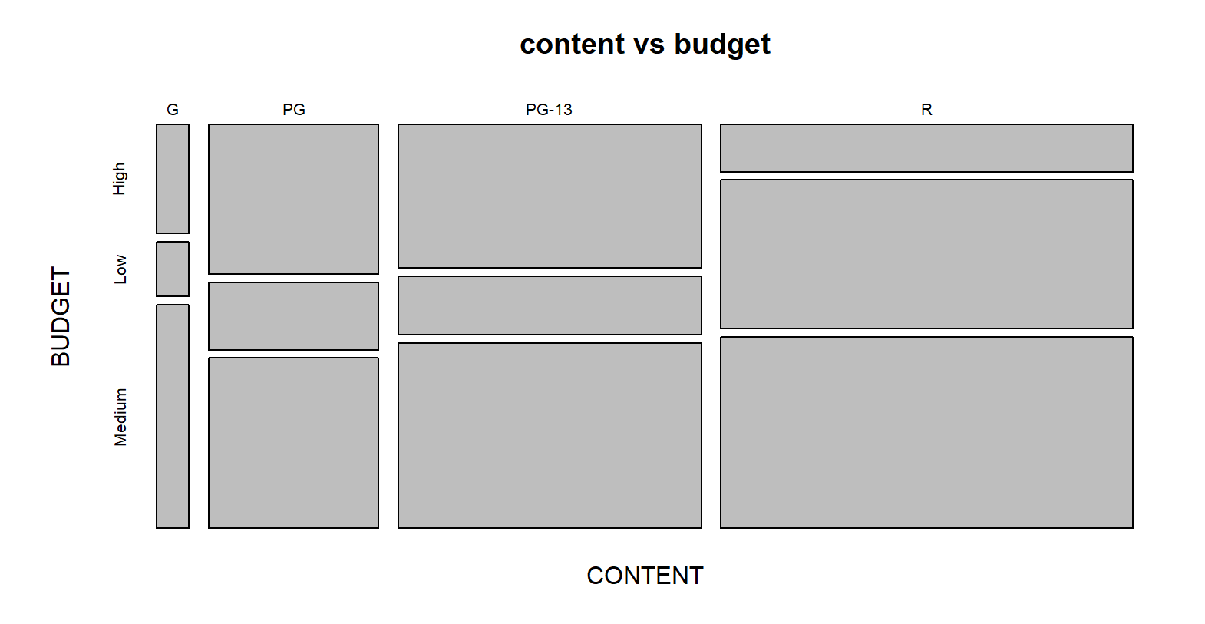
Content vs budget
What’s surprising in this graph, is most low budget are R rated, and most high budget films are PG and PG-13.
Most medium budget films are G rated.

Slide 8
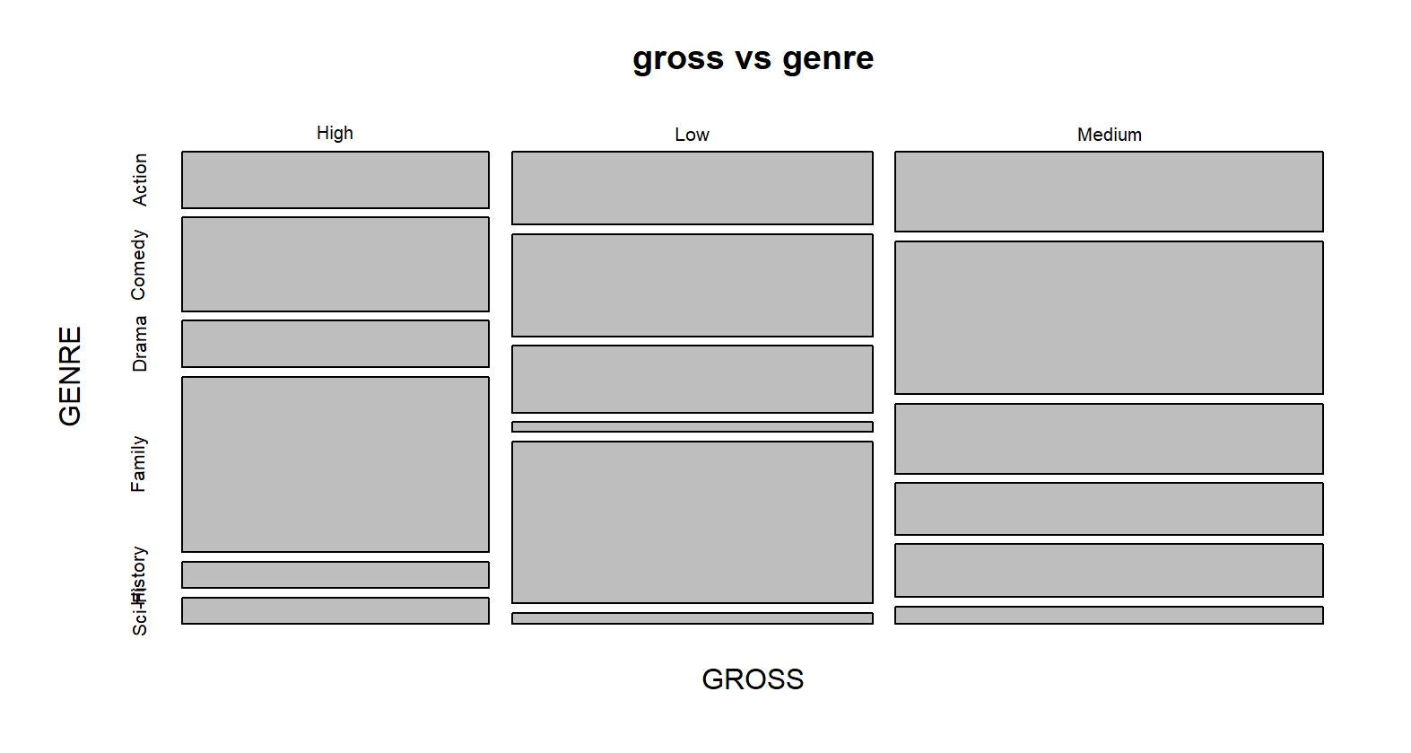
Gross vs genre
Most action and comedy films gross medium, drama films are split, most family films tend to gross either very high or very low, most history films gross low, and most sci-fi films gross high.
An interesting outcome from this graph is that there is a lesser demand for history films as most films gross low and comedy, action and family films tend to gross the highest meaning they have he highest appeal and market.

